Slide 1
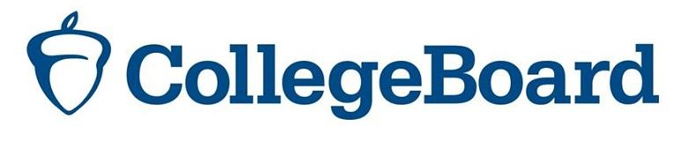
An analysis to explore strategies to boost SAT participation rates & mean total scores across states
Prepared for:
Analysis by:
Lee Shi Min
DSI23

Slide 2
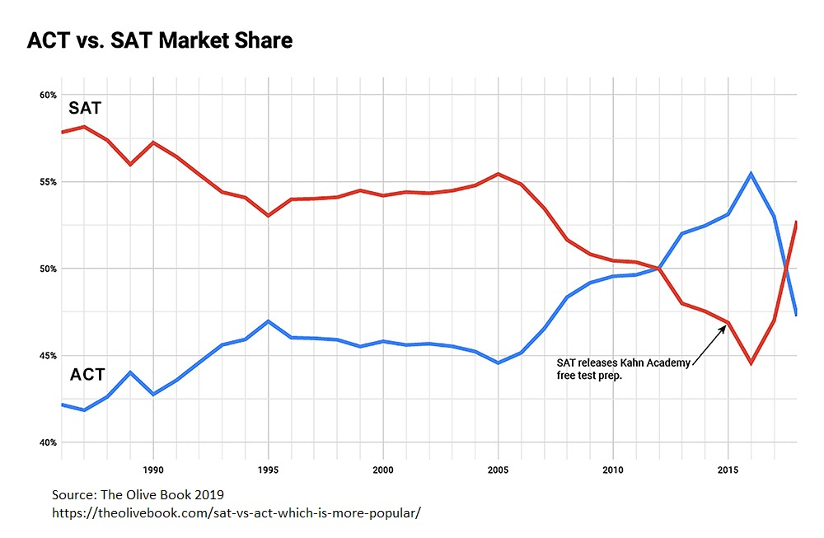
SAT’s Market share has been increasing since 2016…
In 2019, the SAT achieved 55% of the market share.
> 2.2 million students in the class of 2019 took the SAT compared to about 1.8 million students who took the ACT.

Slide 3
Scope and purpose of analysis
In this exploratory study, we deep dive into the 2017 and 2019 datasets to study how participation rates and test scores in SAT and ACT have changed at the state-level.
We intend to draw findings from this exploratory study to identify the following:
States with scope to grow in SAT participation rate
Could apply to states with: i) an increased participation in SAT in 2019 and/or ii) a significant decrease in participation rate for ACT.
States with low average SAT total score
Useful to identify states with poorer test performance so that College Board can better target marketing and/or partnership efforts to improve students' access to the test prep resources.
Effort is aligned with College Board's mandate to expand students' access to higher education.

Slide 4
DATASET for ANALYSIS
We use publicly available datasets on SAT and ACT with the following information:
State participation rates in 2017 and 2019
Mean SAT total score in 2017 and 2019 by state
Mean ACT composite score in 2017 and 2019 by state

Slide 5
Primary Findings FOR SAT
The average SAT participation rate across states increased by 9%-pts in 2019 (up from 39% in 2017).
The SAT participation rate increased at the 25th, 50th and 75th percentile.
8 states fully participated in SAT in 2019, of which 3 fully participated in 2017 too.
Compared to 2017, 36 states increased participation in SAT in 2019, while 4 states decreased their participation in SAT.
In the same time period, the average SAT total score fell by 14 pts (down from 1130 in 2017).
Consistent with the overall decrease in the average SAT total score observed in 2019, we see a decline in mean test score at the 0th, 25th and 50th percentile.

Slide 6
Primary Findings FOR ACT
The average ACT participation rate across states decreased by 7%-pts in 2019 (down from 66% in 2017).
The ACT participation rate decreased at the 0th, 25th, 50th percentile. However, at the 75th percentile, we observe 100% participation rate for ACT.
17 states fully participated in ACT in 2017, but only 15 did so in 2017.
Compared to 2017, 4 states increased participation in ACT in 2019, while 32 states decreased ACT participation.
Compared to 2017, the average ACT composite score remained similar, i.e. it only fell slightly by 0.05 pts in 2019.

Slide 7
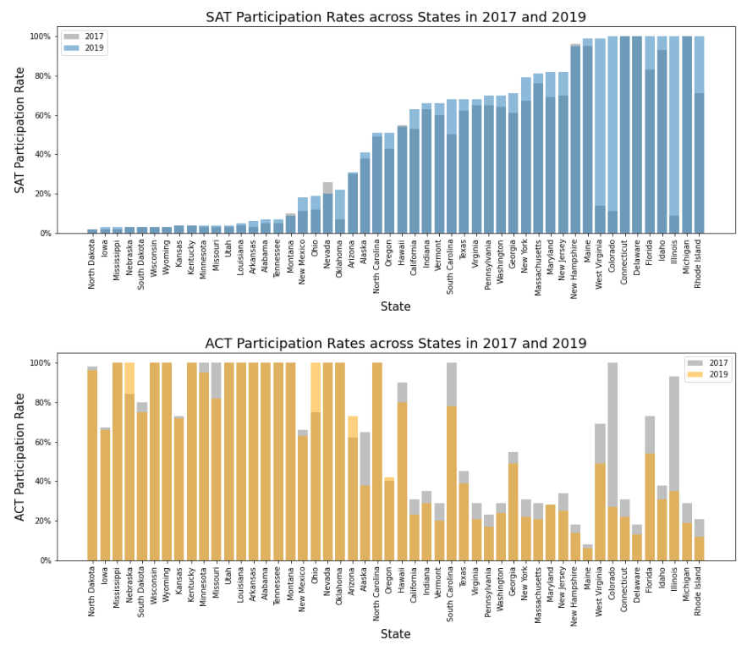
KEY FINDING 1:
States with low participation rates in SAT in 2019 had high participation rates in ACT

Slide 8
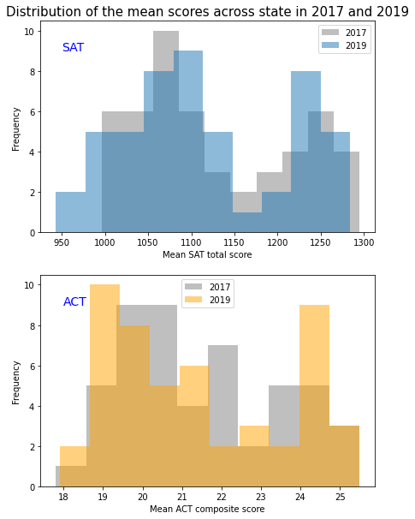
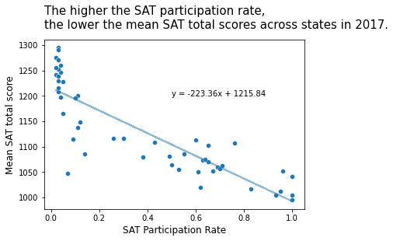
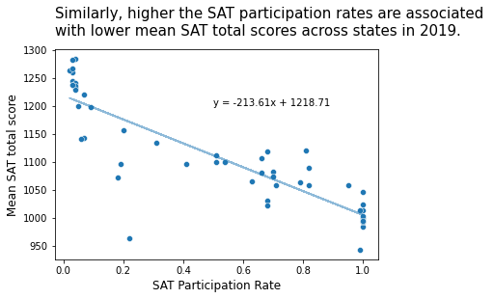
KEY FINDING 2: decline in mean SAT test scores across states in 2019

Slide 9
RECOMMENDATIONS
To boost participation rates, College Board can first target marketing or partnership efforts in the states that had shown a notable decline in their ACT participation rates:
With the decline in mean SAT test scores across states in 2019, College Board should focus on improving students' access to test preparation resources so that students can achieve better test performance in the future. To start, we can target the states with 100% SAT participation rates in 2019, but lower mean SAT total scores than the overall mean of all states:
Missouri
Alaska
Minnesota
South Dakota
Delaware
Idaho
Rhode Island
Florida
Michigan
Illinois
Colorado
Connecticut

Slide 10
THANK YOU

Slide 11
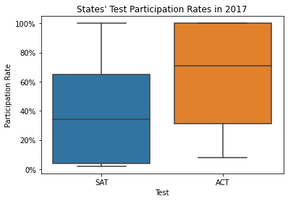
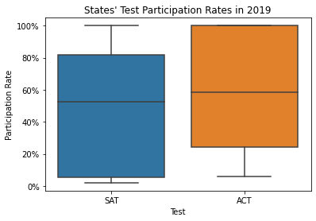
ANNEX 1: BOXPLOTS COMPARING TEST PARTICIPATION RATES

Slide 12
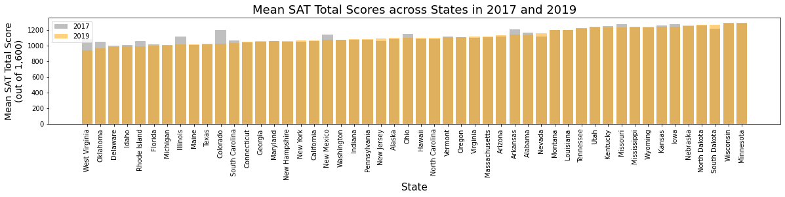
ANNEX 2: MEAN SAT TOTAL SCORE ACROSS STATES IN 2017 and 2019

